Slide 1
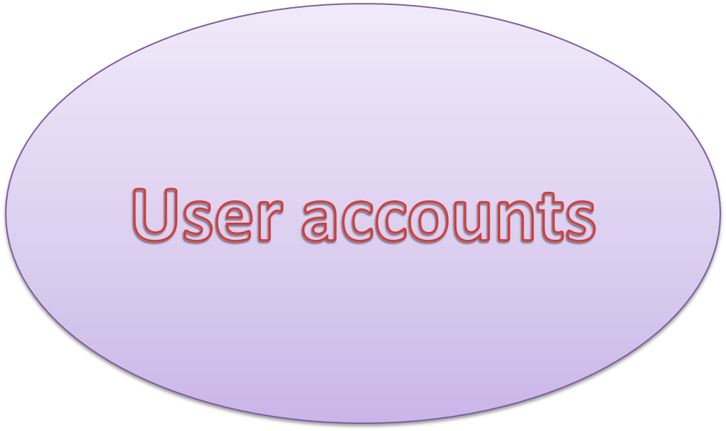

Slide 2
How Linux User Accounts Work
Username
Password
By default, all user home directories are created and maintained in the /home
  directory.
However, the root user’s home directory is /root

Slide 3
Purpose of managing different “User Accounts”
Unix always supported the pool of multiple users working independently and simultaneously on the same computer.
That only authorized users are able to access system. (i.e. username and password)
Each user is assigned a directory, calls home directory ,for sorting the personal data .
Access to resources like file and devices.
e.g.-any authorized user is able to read the “message of the day”

Slide 4
Super users and normal users
Many large systems make a distinction between an SU and NU. Particularly user is prevented from performing sensitive tasks, such as following, unless the user has administrator privileges :
User account management
Periodic backup of data
Global maintantenance and upgrade of the system
Global installation of applications, devices, and their drivers

Slide 5
Why we need to differentiate
SU and NU?
The administrator account in RHL is called root. The power of root is so extensive that almost no task is forbidden for this account. While its impossible for a normal user to delete system files, root is able to delete them all easily.
for this reason, the root account should be used with great care i.e. only by SU.

Slide 6
RHM user and manager
In system when you launch any RHL’s graphical administration tools from a non-root account, Linux will (if necessary)prompt you to enter the password to the root account.

Slide 7
Creating a group
Group are useful when we need to treat a number of different users the same way .for example , if we want to grant a group of users access to a particular file or directory, we add the users to a group and grant the permission to the group (instead of to the individual user accounts).

Slide 8
How linux stores user account information
Local user account info in the following text config files:
Config files
1. /etc/passwd
2. /etc/shadow
3. /etc/group
4. /etc/gshadow

Slide 9
Practice commands
1. How to Add a New User in Linux
2. Create a User with Different Home Directory
3. Create a User with Specific User ID
4. Create a User with Specific Group ID
5. Add a User to Multiple Groups
6. Add a User without Home Directory
7. Create a User with Account Expiry Date
8. Add a User with Custom Comments

Slide 10
9. Add a New Group
10. Add an Existing User Account to a Group
11. Change a User’s Primary Group
12. View the Groups a User Account is Assigned To
13. Create a New User and Assign a Group in One Command
14. Add a User to Multiple Groups
15.

